Slide 1
深さ優先探索 メモ化再帰

Slide 2
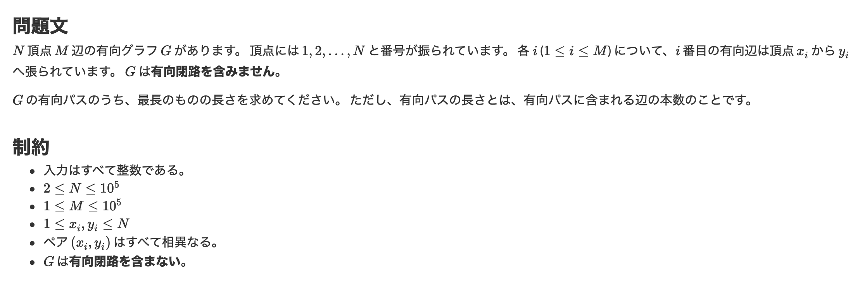
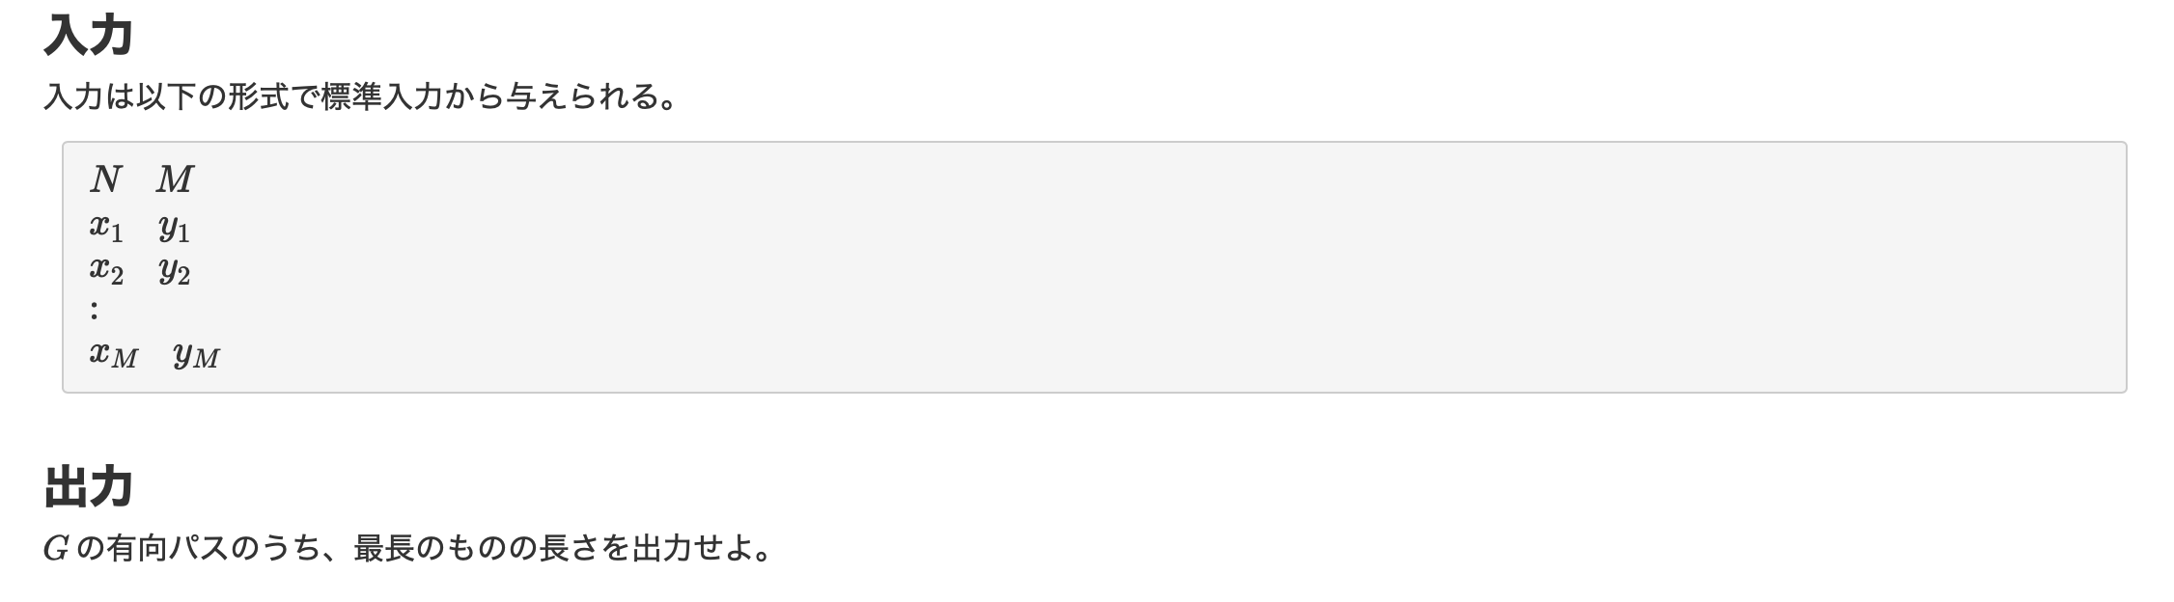

Slide 3
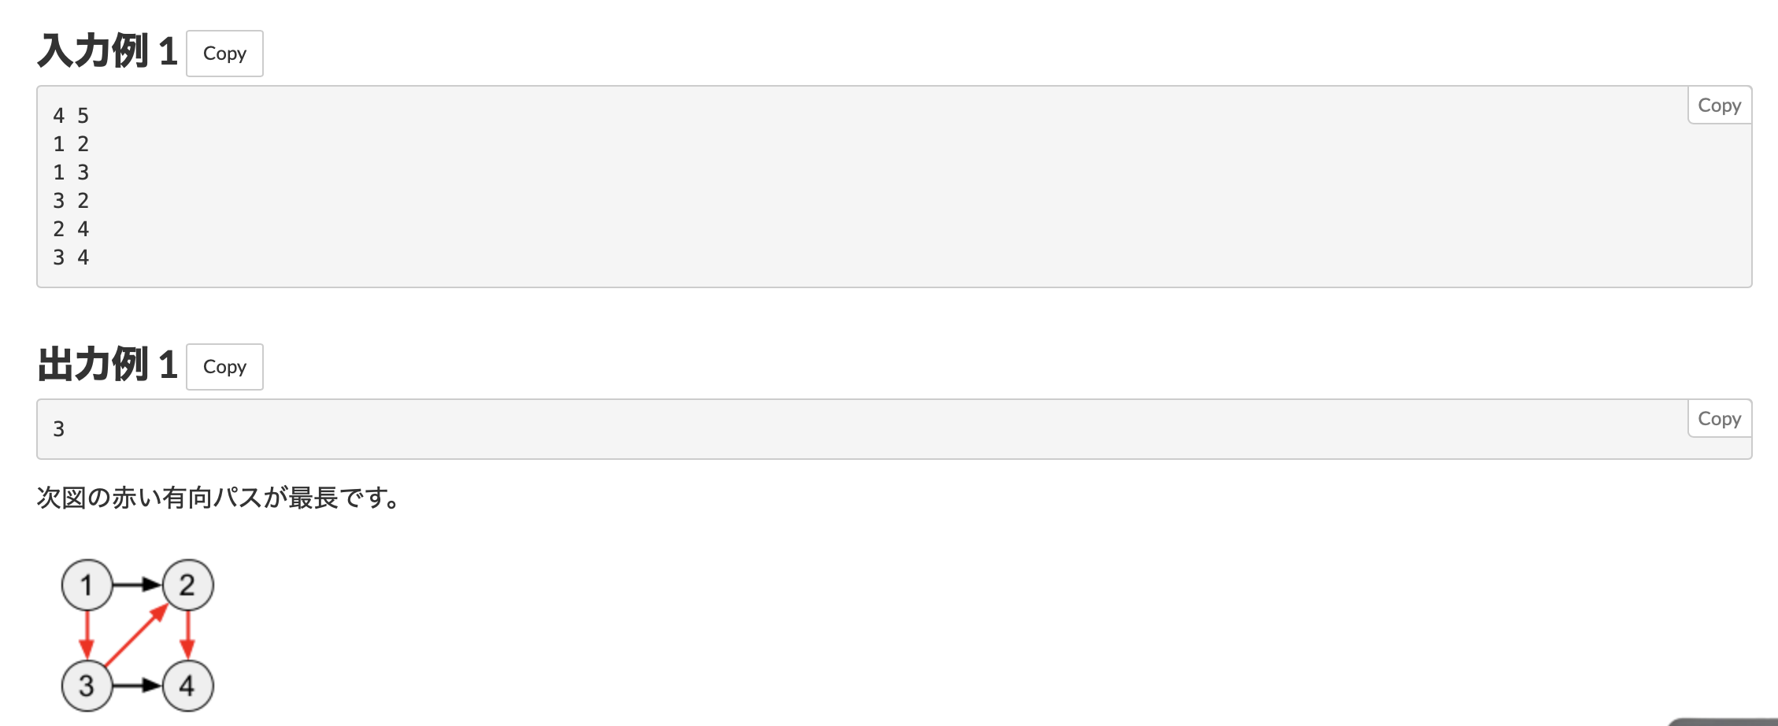

Slide 4
1
2
初期化
N, M = map(int, input().split())
vertices = [[] for i in range(N+1))
dp = [-1] * (N+1)
3
4

Slide 5
1
2
有効グラフ
for _ in range(M):
fro, to = map(int, input().split())
vertices[fro].append(to)
配列
3
4
vertices[]
0
1
2
3
4
[[], [2,3], [4], [2,4], []]

Slide 6
深さ優先探索
1
2
def dfs(i):
if dp[i] != -1:
return dp[i]
tmp = 0
for vertex in vertices[i]:
tmp = max(tmp, dfs(vertex) + 1)
dp[i] = tmp
return tmp
3
4

Slide 7
1
2
全頂点に対する探索
for i in range(1, N+1):
dfs(i)
print(max(dp))
3
4

Slide 8
深さ優先探索
def dfs(i):
if dp[i] != -1:
return dp[i]
tmp = 0
for vertex in vertices[i]:
tmp = max(tmp, dfs(vertex) + 1)
dp[i] = tmp
return tmp
1
2
3
4
配列
vertices[]
0
1
2
3
4
[[], [2,3], [4], [2,4], []]

Slide 9
深さ優先探索
def dfs(i):
if dp[i] != -1:
return dp[i]
tmp = 0
for vertex in vertices[i]:
tmp = max(tmp, dfs(vertex) + 1)
dp[i] = tmp
return tmp
1
2
探索済み条件
3
4
配列
vertices[]
0
1
2
3
4
[[], [2,3], [4], [2,4], []]

Slide 10
深さ優先探索
def dfs(i):
if dp[i] != -1:
return dp[i]
tmp = 0
for vertex in vertices[i]:
tmp = max(tmp, dfs(vertex) + 1)
dp[i] = tmp
return tmp
1
2
3
4
配列
vertices[]
0
1
2
3
4
[[], [2,3], [4], [2,4], []]

Slide 11
深さ優先探索
def dfs(i):
if dp[i] != -1:
return dp[i]
tmp = 0
for vertex in vertices[i]:
tmp = max(tmp, dfs(vertex) + 1)
dp[i] = tmp
return tmp
1
2
3
4
配列
vertices[]
0
1
2
3
4
[[], [2,3], [4], [2,4], []]

Slide 12
深さ優先探索
def dfs(i):
if dp[i] != -1:
return dp[i]
tmp = 0
for vertex in vertices[i]:
tmp = max(tmp, dfs(vertex) + 1)
dp[i] = tmp
return tmp
1
2
tmp = 2
3
4
配列
vertices[]
0
1
2
3
4
[[], [2,3], [4], [2,4], []]
空!!!

Slide 13
深さ優先探索
dp[1] = 2
def dfs(i):
if dp[i] != -1:
return dp[i]
tmp = 0
for vertex in vertices[i]:
tmp = max(tmp, dfs(vertex) + 1)
dp[i] = tmp
return tmp
1
2
tmp = 2
3
4
配列
vertices[]
0
1
2
3
4
[[], [2,3], [4], [2,4], []]

Slide 14
深さ優先探索
dp[1] = 2
def dfs(i):
if dp[i] != -1:
return dp[i]
tmp = 0
for vertex in vertices[i]:
tmp = max(tmp, dfs(vertex) + 1)
dp[i] = tmp
return tmp
1
2
tmp = 2
3
4
配列
vertices[]
0
1
2
3
4
[[], [2,3], [4], [2,4], []]

Slide 15
深さ優先探索
dp[1] = 2
def dfs(i):
if dp[i] != -1:
return dp[i]
tmp = 0
for vertex in vertices[i]:
tmp = max(tmp, dfs(vertex) + 1)
dp[i] = tmp
return tmp
1
2
maxでtmp = 2が取れる
3
4
配列
vertices[]
0
1
2
3
4
[[], [2,3], [4], [2,4], []]

Slide 16
深さ優先探索
dp[1] = 2
def dfs(i):
if dp[i] != -1:
return dp[i]
tmp = 0
for vertex in vertices[i]:
tmp = max(tmp, dfs(vertex) + 1)
dp[i] = tmp
return tmp
1
2
maxでtmp = 2が取れる
3
4
配列
vertices[]
0
1
2
3
4
[[], [2,3], [4], [2,4], []]

Slide 17
深さ優先探索
dp[1] = 2
def dfs(i):
if dp[i] != -1:
return dp[i]
tmp = 0
for vertex in vertices[i]:
tmp = max(tmp, dfs(vertex) + 1)
dp[i] = tmp
return tmp
1
2
3
4
配列
vertices[]
0
1
2
3
4
[[], [2,3], [4], [2,4], []]

Slide 18
深さ優先探索
dp[1] = 2
def dfs(i):
if dp[i] != -1:
return dp[i]
tmp = 0
for vertex in vertices[i]:
tmp = max(tmp, dfs(vertex) + 1)
dp[i] = tmp
return tmp
1
2
3
4
配列
vertices[]
0
1
2
3
4
[[], [2,3], [4], [2,4], []]

Slide 19
深さ優先探索
dp[1] = 3
def dfs(i):
if dp[i] != -1:
return dp[i]
tmp = 0
for vertex in vertices[i]:
tmp = max(tmp, dfs(vertex) + 1)
dp[i] = tmp
return tmp
1
2
tmp = 3 dp[1]更新！！
3
4
配列
vertices[]
0
1
2
3
4
[[], [2,3], [4], [2,4], []]

Slide 20
深さ優先探索
dp[1] = 3
def dfs(i):
if dp[i] != -1:
return dp[i]
tmp = 0
for vertex in vertices[i]:
tmp = max(tmp, dfs(vertex) + 1)
dp[i] = tmp
return tmp
1
2
maxでtmp = 3が取れる
3
4
配列
vertices[]
0
1
2
3
4
[[], [2,3], [4], [2,4], []]

Slide 21
深さ優先探索
dp[1] = 3
def dfs(i):
if dp[i] != -1:
return dp[i]
tmp = 0
for vertex in vertices[i]:
tmp = max(tmp, dfs(vertex) + 1)
dp[i] = tmp
return tmp
1
2
maxでtmp = 3が取れる
3
4
配列
vertices[]
0
1
2
3
4
[[], [2,3], [4], [2,4], []]

Slide 22
深さ優先探索
dp[1] = 3
def dfs(i):
if dp[i] != -1:
return dp[i]
tmp = 0
for vertex in vertices[i]:
tmp = max(tmp, dfs(vertex) + 1)
dp[i] = tmp
return tmp
1
2
tmp = 2
3
4
配列
vertices[]
0
1
2
3
4
[[], [2,3], [4], [2,4], []]

Slide 23
深さ優先探索
dp[1] = 3
def dfs(i):
if dp[i] != -1:
return dp[i]
tmp = 0
for vertex in vertices[i]:
tmp = max(tmp, dfs(vertex) + 1)
dp[i] = tmp
return tmp
1
2
maxでtmp = 3が取れる
tmp = 2
3
4
配列
vertices[]
0
1
2
3
4
[[], [2,3], [4], [2,4], []]

Slide 24
深さ優先探索
dp[1] = 3
def dfs(i):
if dp[i] != -1:
return dp[i]
tmp = 0
for vertex in vertices[i]:
tmp = max(tmp, dfs(vertex) + 1)
dp[i] = tmp
return tmp
1
2
maxでtmp = 3が取れる
3
4
配列
vertices[]
0
1
2
3
4
[[], [2,3], [4], [2,4], []]

Slide 25
深さ優先探索
dp[1] = 3
def dfs(i):
if dp[i] != -1:
return dp[i]
tmp = 0
for vertex in vertices[i]:
tmp = max(tmp, dfs(vertex) + 1)
dp[i] = tmp
return tmp
1
2
maxでtmp = 3が取れる
3
4
配列
vertices[]
0
1
2
3
4
[[], [2,3], [4], [2,4], []]

Slide 26
深さ優先探索
dp[1] = 3
def dfs(i):
if dp[i] != -1:
return dp[i]
tmp = 0
for vertex in vertices[i]:
tmp = max(tmp, dfs(vertex) + 1)
dp[i] = tmp
return tmp
1
2
3
4
配列
vertices[]
0
1
2
3
4
[[], [2,3], [4], [2,4], []]

Slide 27
深さ優先探索
dp[1] = 3
def dfs(i):
if dp[i] != -1:
return dp[i]
tmp = 0
for vertex in vertices[i]:
tmp = max(tmp, dfs(vertex) + 1)
dp[i] = tmp
return tmp
1
2
3
4
配列
vertices[]
0
1
2
3
4
[[], [2,3], [4], [2,4], []]

Slide 28
深さ優先探索
dp[1] = 3
dp[2] = 1
def dfs(i):
if dp[i] != -1:
return dp[i]
tmp = 0
for vertex in vertices[i]:
tmp = max(tmp, dfs(vertex) + 1)
dp[i] = tmp
return tmp
1
2
3
4
配列
vertices[]
0
1
2
3
4
[[], [2,3], [4], [2,4], []]

Slide 29
深さ優先探索
dp[1] = 3
dp[2] = 1
def dfs(i):
if dp[i] != -1:
return dp[i]
tmp = 0
for vertex in vertices[i]:
tmp = max(tmp, dfs(vertex) + 1)
dp[i] = tmp
return tmp
1
2
3
4
配列
vertices[]
0
1
2
3
4
[[], [2,3], [4], [2,4], []]

Slide 30
深さ優先探索
dp[1] = 3
dp[2] = 1
def dfs(i):
if dp[i] != -1:
return dp[i]
tmp = 0
for vertex in vertices[i]:
tmp = max(tmp, dfs(vertex) + 1)
dp[i] = tmp
return tmp
1
2
3
4
配列
vertices[]
0
1
2
3
4
[[], [2,3], [4], [2,4], []]

Slide 31
深さ優先探索
dp[1] = 3
dp[2] = 1
def dfs(i):
if dp[i] != -1:
return dp[i]
tmp = 0
for vertex in vertices[i]:
tmp = max(tmp, dfs(vertex) + 1)
dp[i] = tmp
return tmp
1
2
3
4
配列
vertices[]
0
1
2
3
4
dp[3] = 2
[[], [2,3], [4], [2,4], []]

Slide 32
深さ優先探索
dp[1] = 3
dp[2] = 1
def dfs(i):
if dp[i] != -1:
return dp[i]
tmp = 0
for vertex in vertices[i]:
tmp = max(tmp, dfs(vertex) + 1)
dp[i] = tmp
return tmp
1
2
3
4
配列
vertices[]
0
1
2
3
4
dp[3] = 2
[[], [2,3], [4], [2,4], []]

Slide 33
深さ優先探索
dp[1] = 3
dp[2] = 1
def dfs(i):
if dp[i] != -1:
return dp[i]
tmp = 0
for vertex in vertices[i]:
tmp = max(tmp, dfs(vertex) + 1)
dp[i] = tmp
return tmp
1
2
3
4
配列
vertices[]
0
1
2
3
4
dp[3] = 2
dp[4] = 0
[[], [2,3], [4], [2,4], []]

Slide 34
dp[1] = 3
dp[2] = 1
1
2
最長距離 dp[1] = 3
3
4
dp[3] = 2
dp[4] = 0

